Slide 1

About Gaoxiang cs5610 project1 Gaoxiang zhang

Slide 2

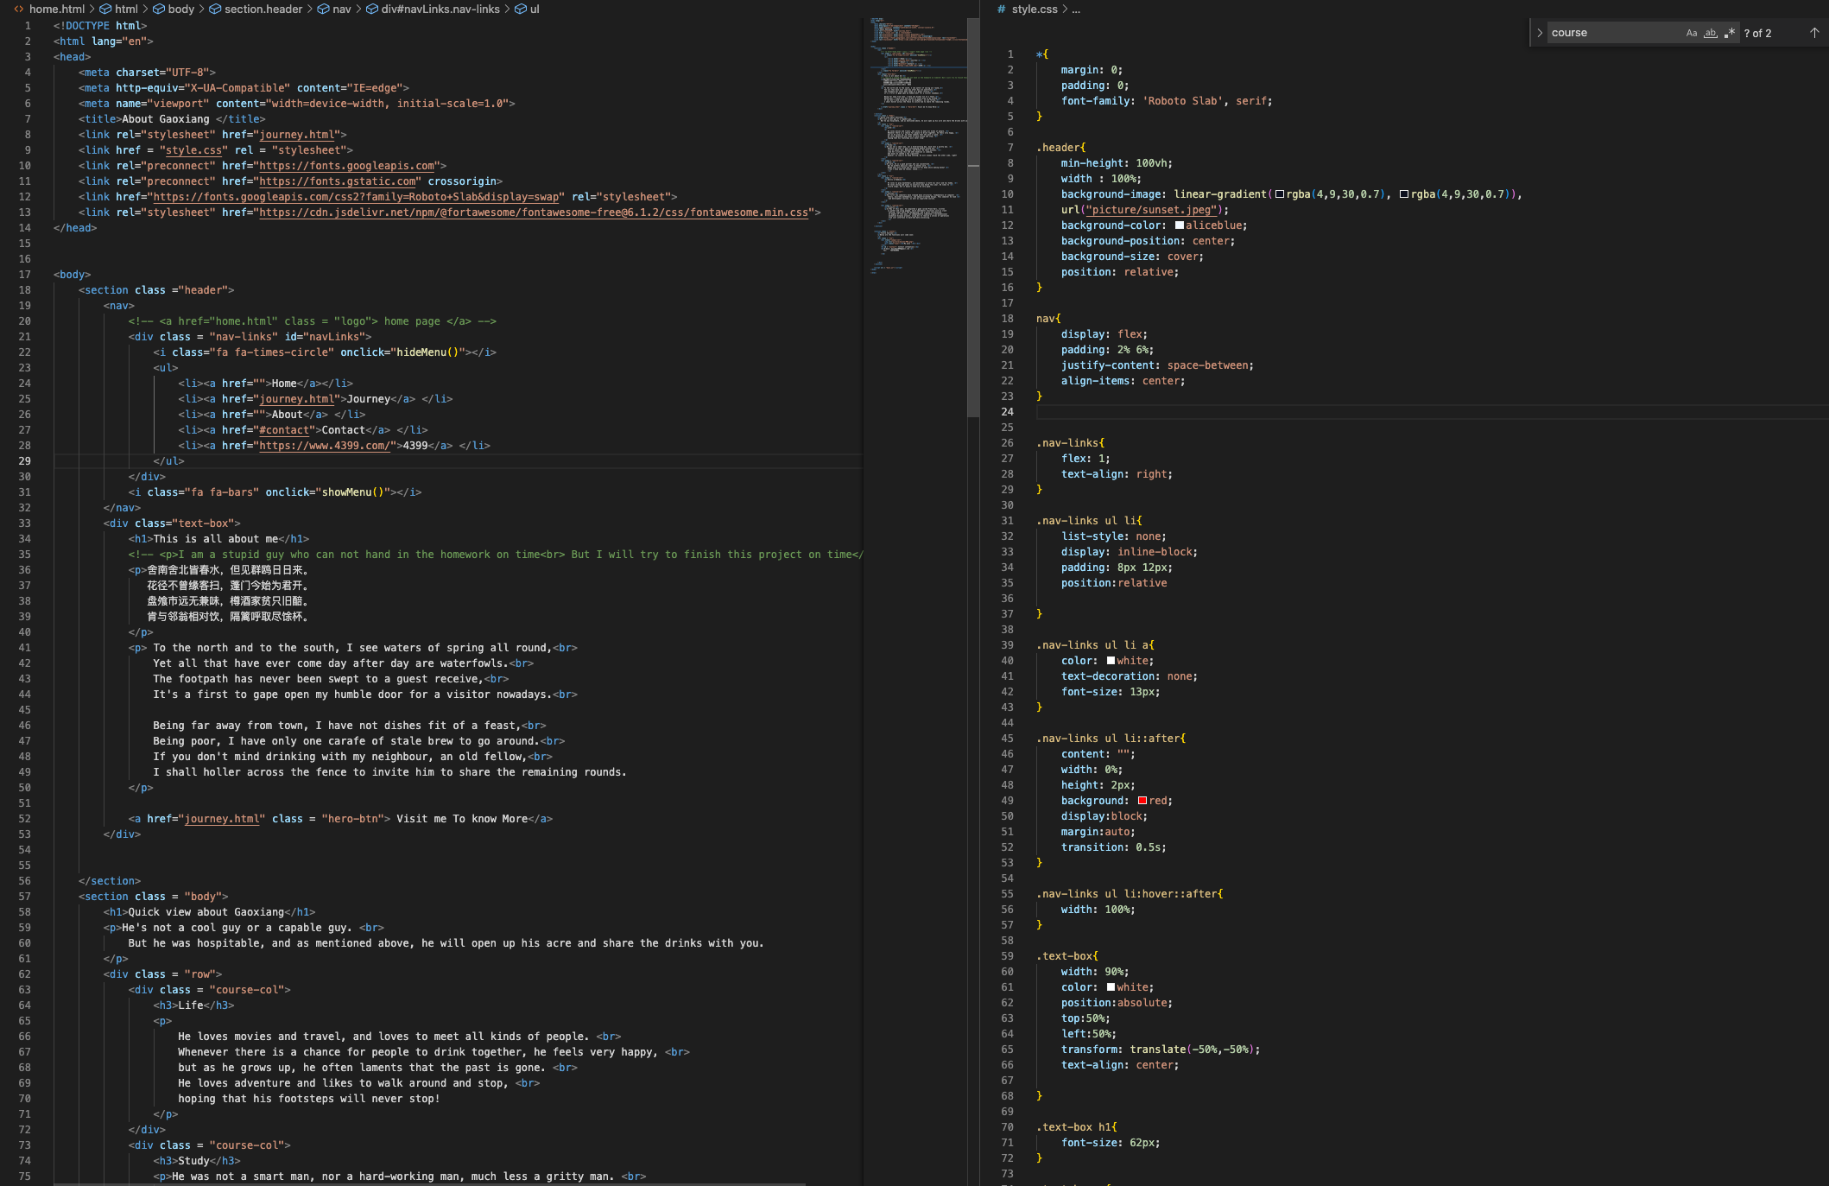
Css + html + js

Slide 3
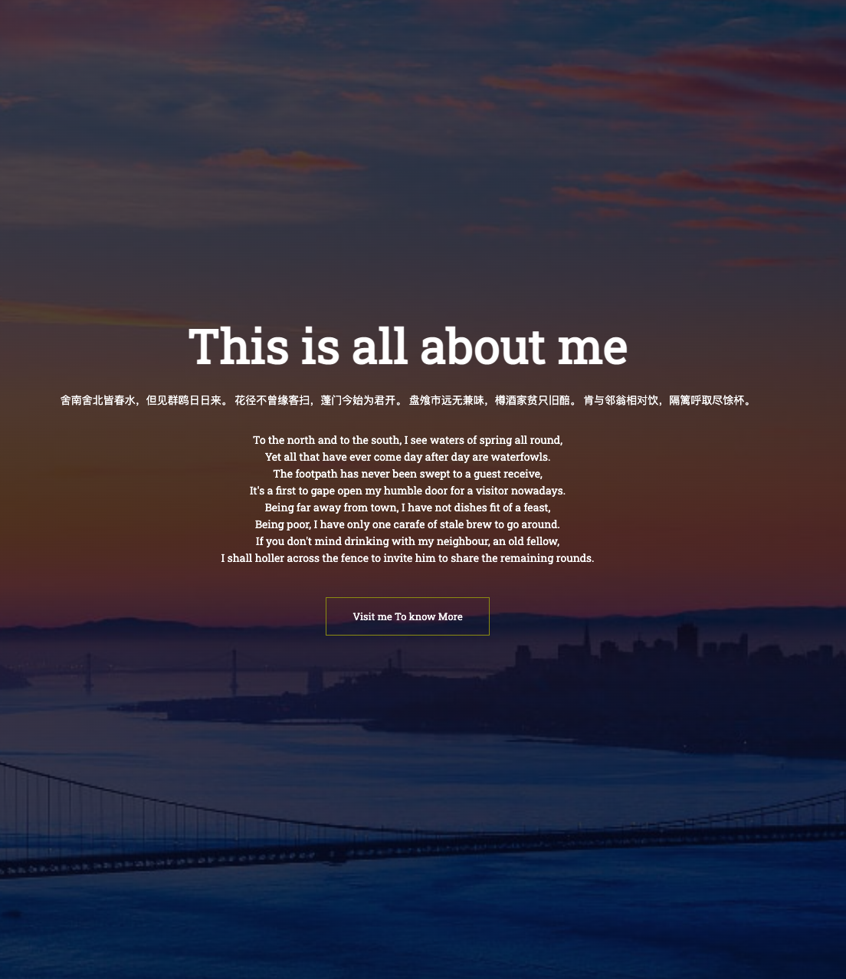
Home Page
This is the home page of my website, I use a I used an ancient Chinese poem to welcome people who can visit my website.
At the bottom is a button that can be clicked to jump to a more detailed page

Slide 4
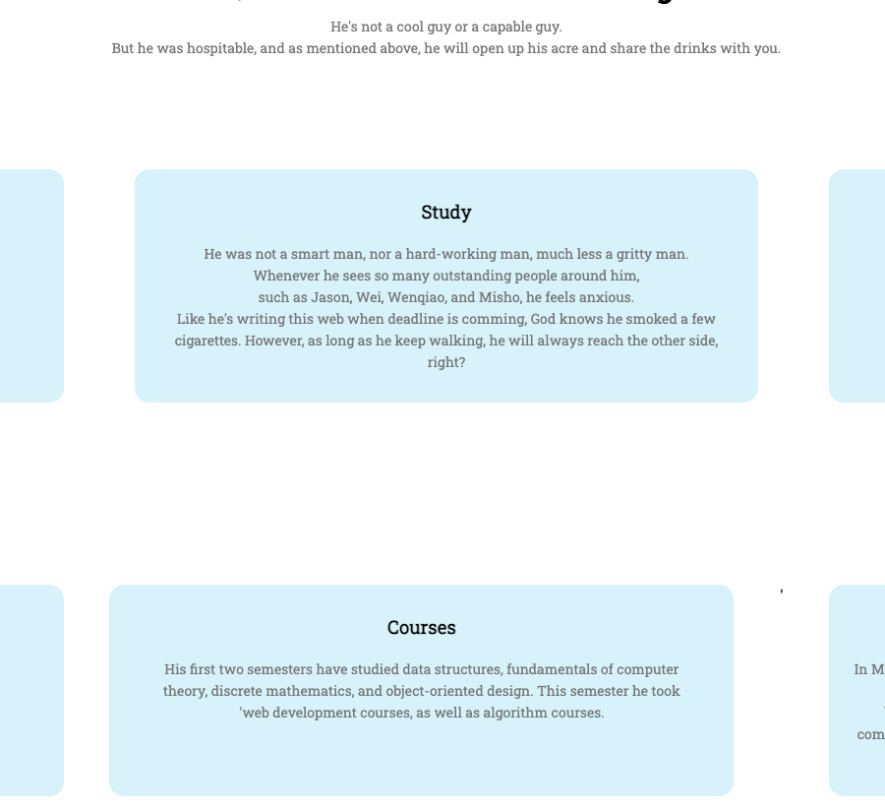
Introduction
Here are some simple self-introductions with descriptions of my life, studies, work, interests, courses, and projects

Slide 5
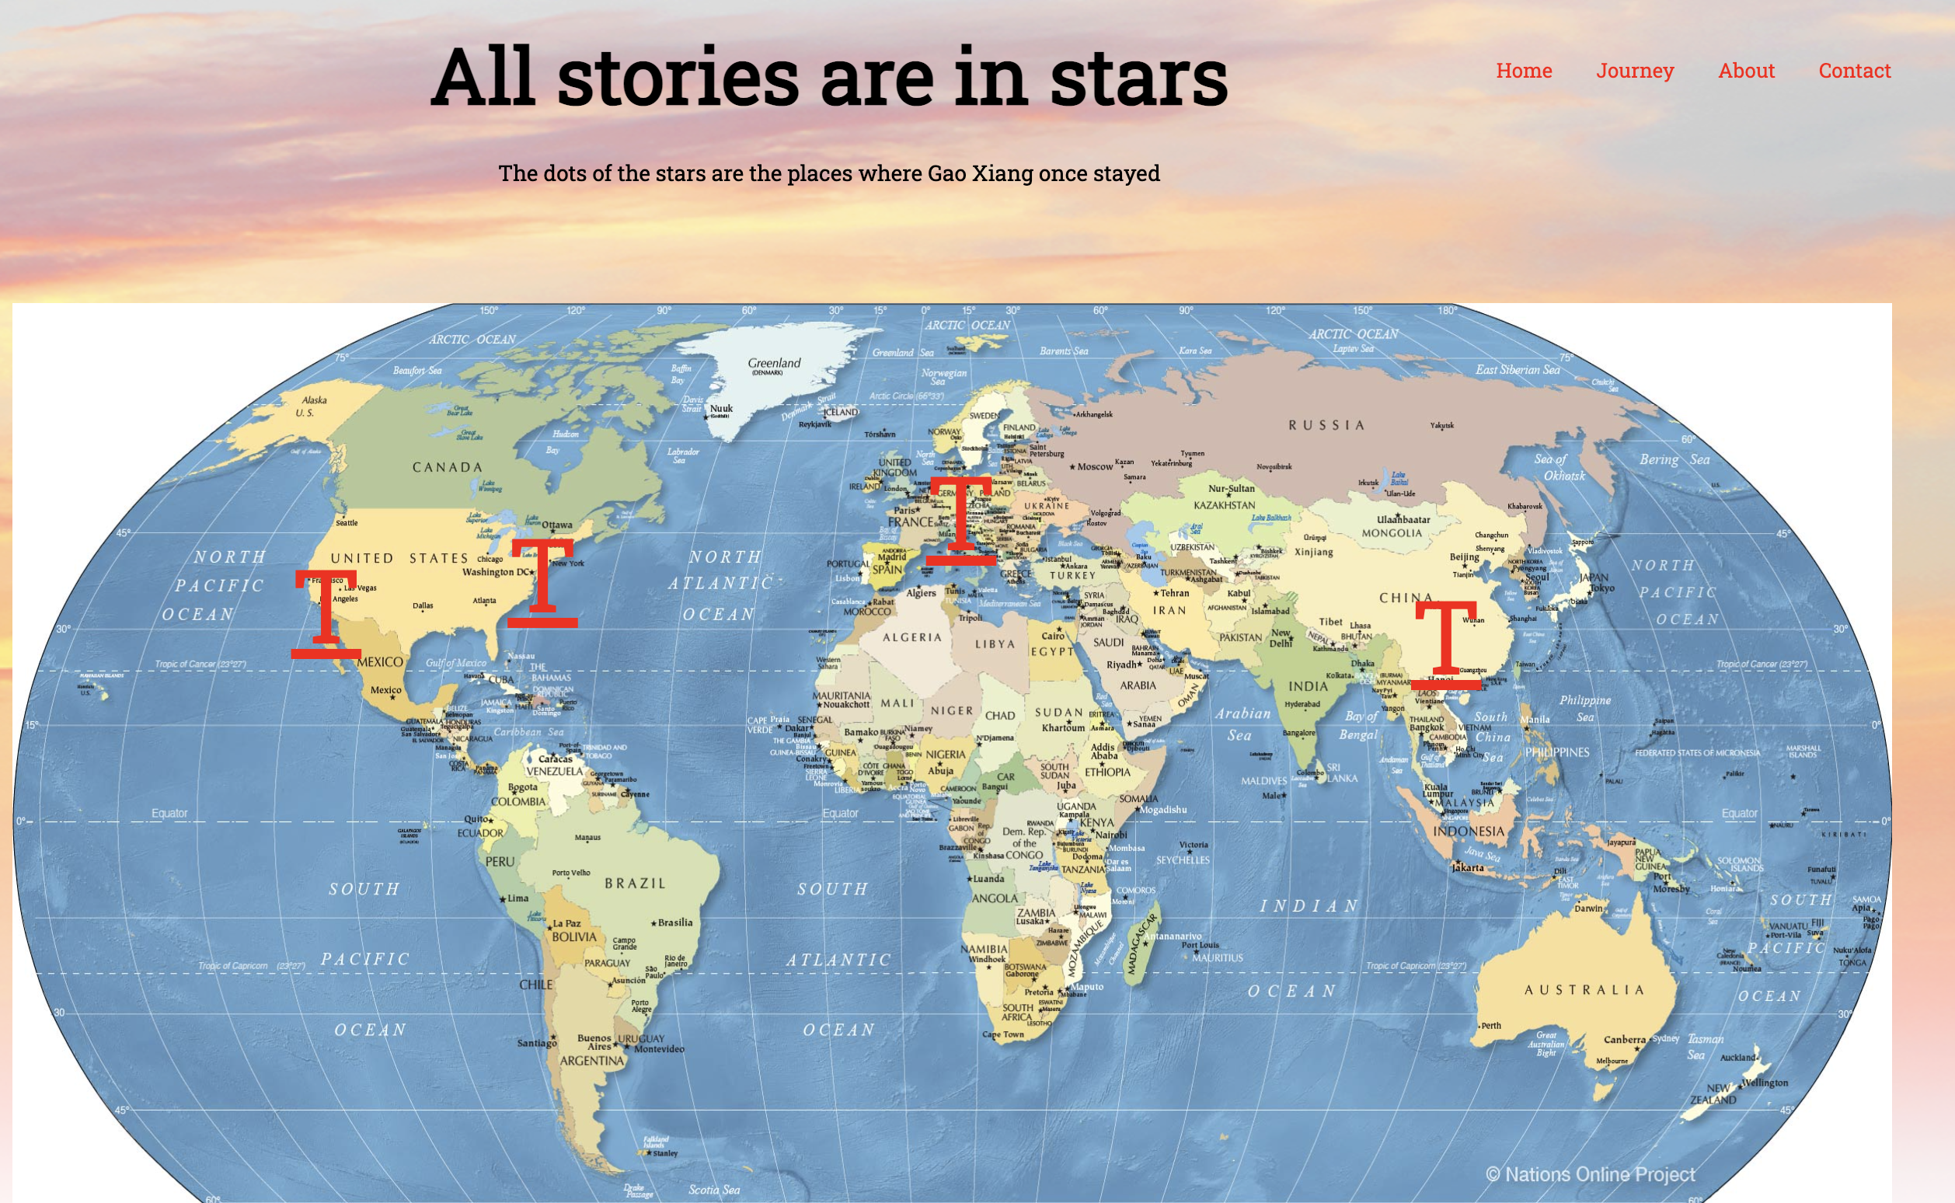
BALANCING ACT
Use this color palette when you want a balance between warm and cool. PANTONE Very Peri is intensified within this artfully calibrated palette, injecting a feeling of liveliness and visual vibration.

Slide 6
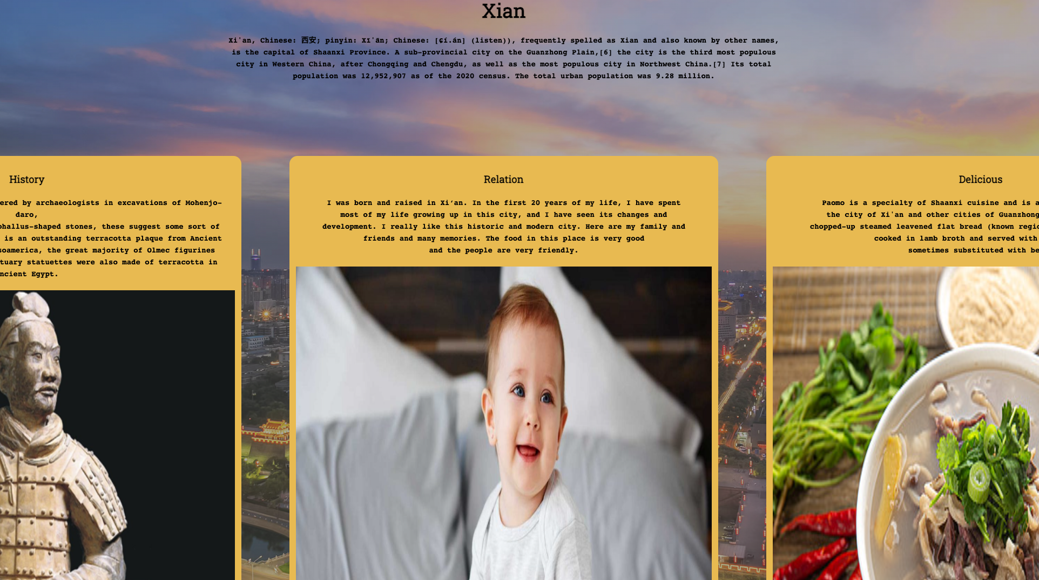
BALANCING ACT
Use this color palette when you want a balance between warm and cool. PANTONE Very Peri is intensified within this artfully calibrated palette, injecting a feeling of liveliness and visual vibration.

Slide 7

Thnak You
By building this website, I have learned a lot about Css、html and jave-script. I become more confident when talk about web-development. Hope I can make it better in the future.

